Slide 1
naukri Analysis

Slide 2

MENTORS NAME:
STEPHY
TEAM MEMBER NAME:
DHARMI DINESHBHAI LODALIYA
TELANG MONIKA SHASHIKANTH
V.G LOKESH
SANDEEP H R
DIVYA THEERTHAGIRI
RAVI KIRAN THOTA
GUVVALAPALLI RAJESH

Slide 3

OBJECTIVE
This project scrapes and analyzes Naukri job data to uncover insights on skills, tech trends, and salaries.
It aims to guide job seekers and businesses using data-driven analysis and machine learning.

Slide 4
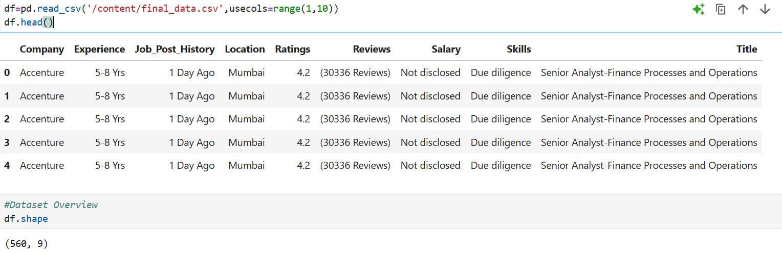
DATA SET DETAILS:
DATA SET USED :ROWS-560,COLUMNS-9
Company
Experience, in years.
Job_Post_History, in days.
Location, in cities.
Ratings,in numerical.
Reviews, in numerical.
Salary, in objective.
Skills , in Due diligence.
Title(Target), finding job.

Slide 5

AGENDA:
PERFORMING EDA
DETECTING OUTLIERS
FEATURE EXTRACTION
MODEL BUILDING
.MODEL IMPLEMENTING
RESULTS

Slide 6
PERFORMING EDA(EXPLORATORY DATA ANALYSIS)
Advantages: Disadvantages:
Understanding Data:
EDA helps analysts gain a foundational understanding of datasets, including Time-Consuming:
identifying patterns, outliers, and relationship EDA can be a time-consuming process, especially for large and complex dataset
Data Quality Assessment:
EDA facilitates the identification of missing values, errors, and inconsistencies, Requires Expertise
leading to improved data quality EDA requires a certain level of expertise in data analysis and visualization
techniques
Feature Selection:
EDA helps in identifying the most relevant features for building models
and predicting outcome
Improved Decision-Making:
By understanding the data's underlying structures and relationships, EDA
can support better decision-making
Model Building:
EDA helps in choosing the right methods for analysis and model building

Slide 7
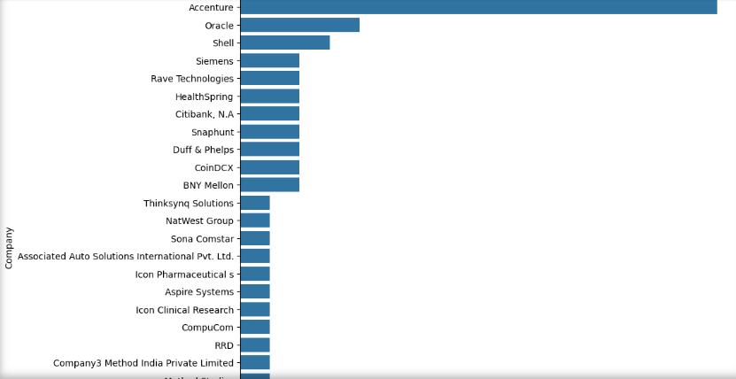
Visualisation :histogram
Histograms are a variation of bar charts, but there are no gaps between the bars in a histogram
In this individual features histogram charts are presented
Histograms are used in many industries, including finance, public health, environmental science, manufacturing, and social studies

Slide 8
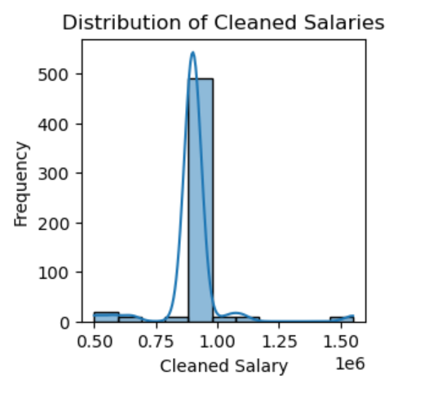
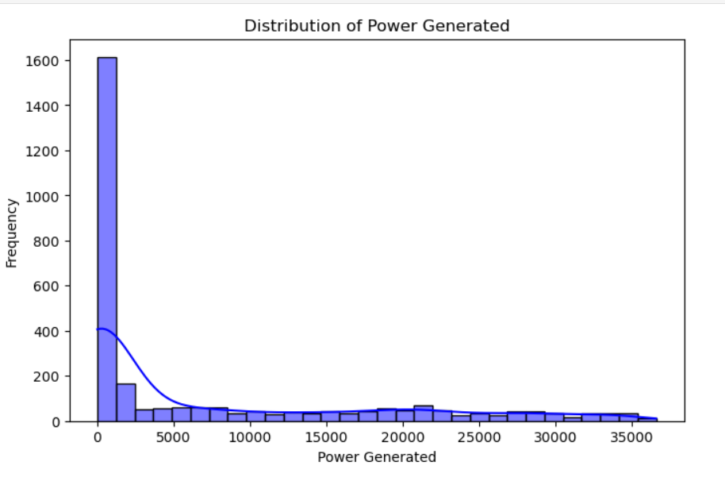
Distribution of pairplot of CLEANED SALARIES feature
We can understand the cleand salaries of for all feature variables.

Slide 9
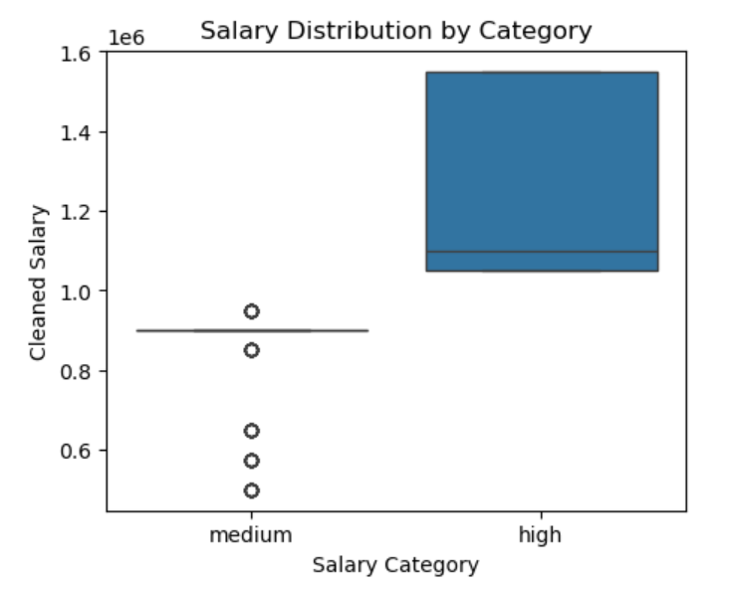
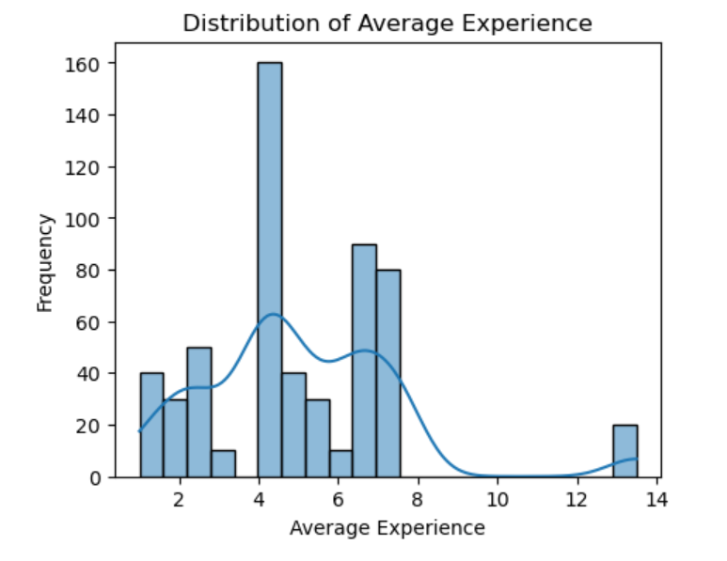
DISTRIBUTION individual feature
distance-to-solar-noon: 0 outliers found
temperature: 0 outliers found
wind-direction: 528 outliers found
wind-speed: 40 outliers found
sky-cover: 0 outliers found
visibility: 429 outliers found
humidity: 83 outliers found
average-wind-speed-(period): 0 outliers found
average-pressure-(period): 31 outliers found
power-generated: 107 outliers found

Slide 10
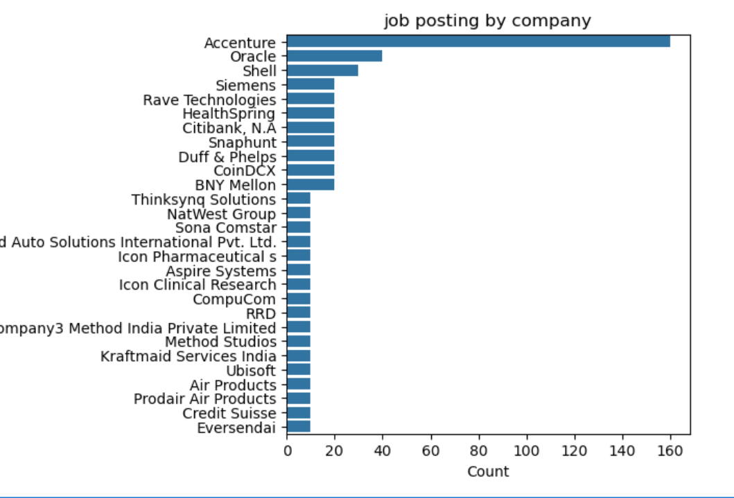
COUNT THE FREQUINCE
Count the frequnies of each company.

Slide 11
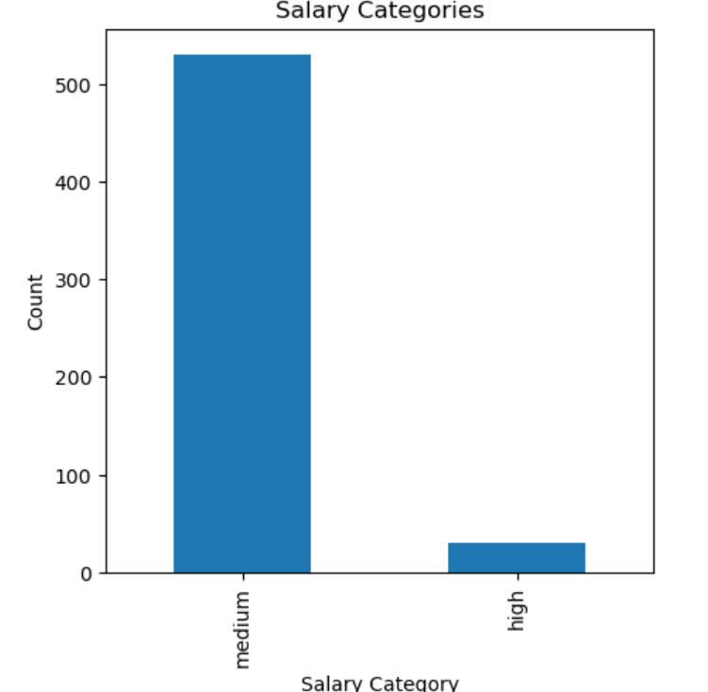
SALARY CATEGORIES

Slide 12
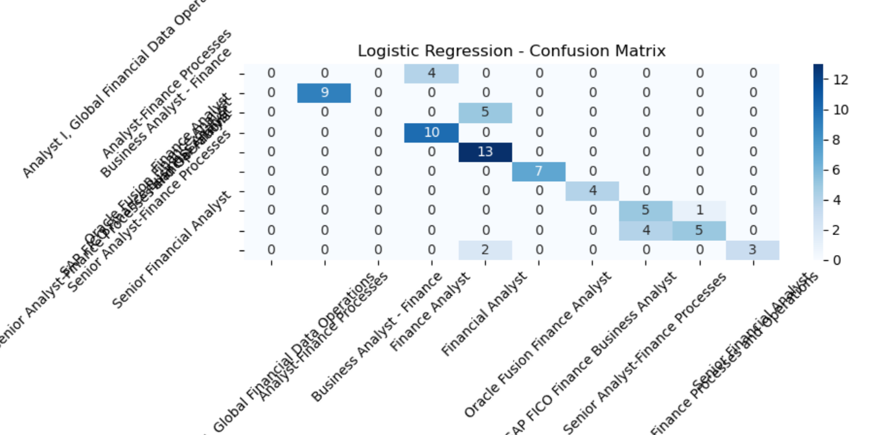
LOGISTICT REGRESSION

Slide 13
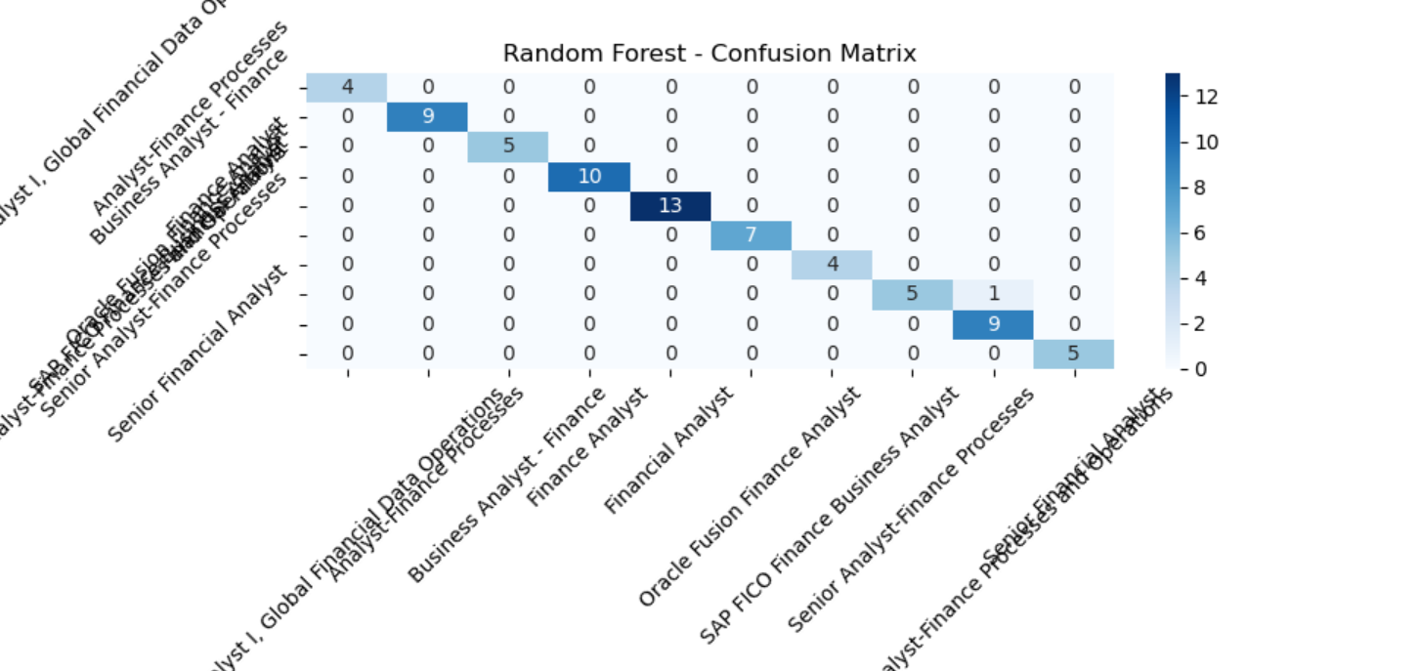
RANDOM FOREST

Slide 14
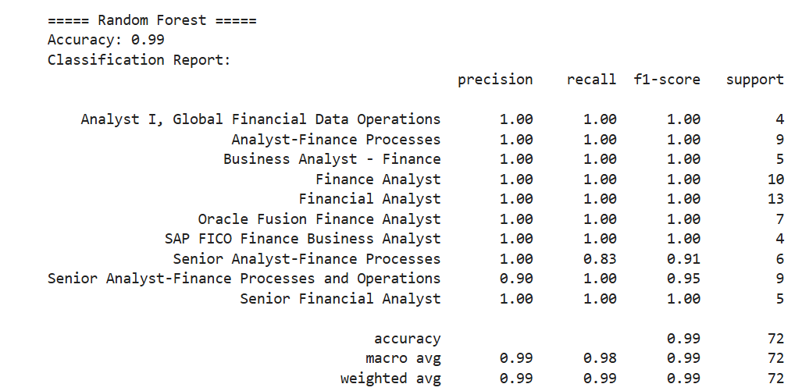
rANDOM FOREST OUTPUT SCORE

Slide 15
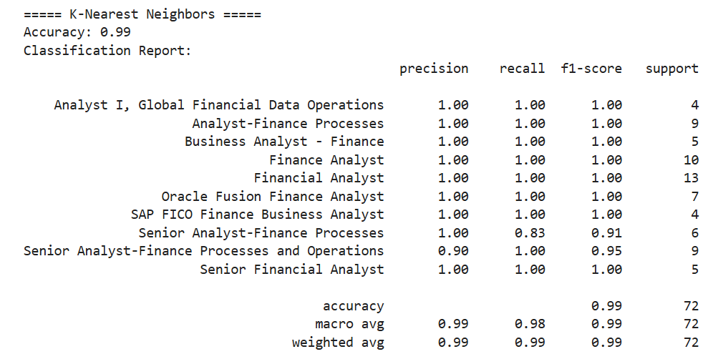
K-NEAREST NEIGHBORS SCORE

Slide 16
Why dbscan not kmeans:
DBSCAN is often preferred over K-means because it can identify clusters of arbitrary shapes and sizes, doesn't require specifying the number of clusters beforehand, and is robust to noise and outliers, whereas K-means assumes spherical clusters and struggles with irregular shapes and noise.
Dbscan advantages:
Handle arbitrary shape
Density based
K-means Advantages:
Simplicity and Speed
Scalability:.
Visualizatition

Slide 17
Models: lineanr regression
Linear regression is a statistical method used to model the relationship between a dependent variable and one or more independent variables. It provides valuable insights for prediction and data analysis
Limitations:
Linearity Assumption:
Sensitivity to Outliers
Multicollinearity

Slide 18
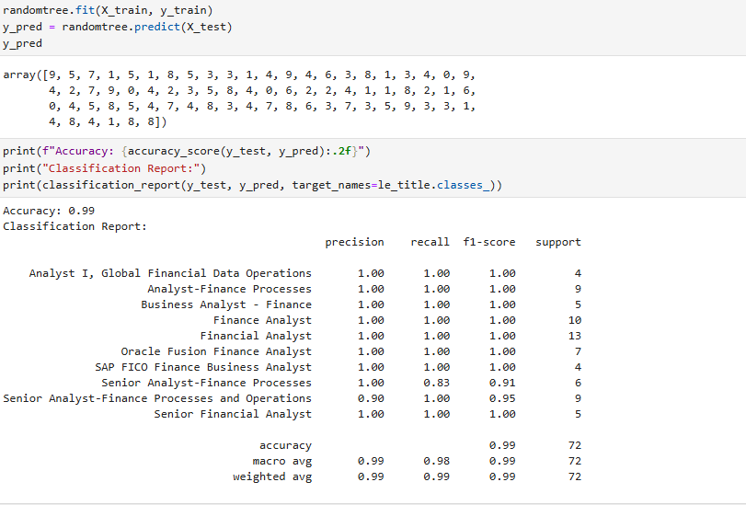
RANDOM FOREST CLASSIFICATION REPORT

Slide 19
Random forest
Random Forest Regression, a machine learning algorithm, is used for predicting continuous values by combining multiple decision trees, which reduces overfitting and improves accuracy and robustness compared to single decision trees
In regression task we can use Random Forest Regression technique for predicting numerical values. It predicts continuous values by averaging the results of multiple decision trees.

Slide 20
Xgboost:
XGBoost is an optimized implementation of Gradient Boosting and is a type of ensemble learning method. Ensemble learning combines multiple weak models to form a stronger model.
XGBoost uses decision trees as its base learners combining them sequentially to improve the model’s performance. Each new tree is trained to correct the errors made by the previous tree and this process is called boosting
Best result given from all models is xgboost so we are choosen xgboost model for deployment.

Slide 21
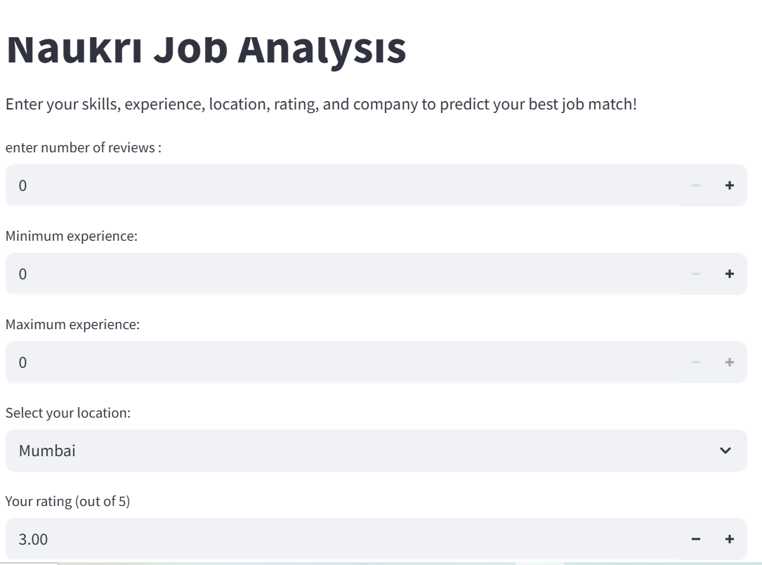

Slide 22
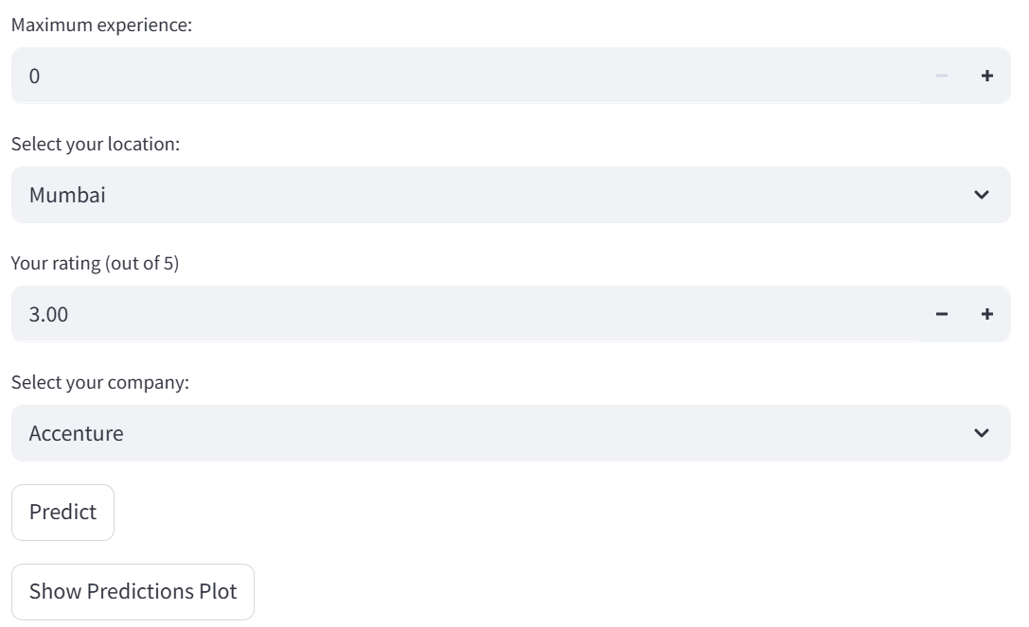

Slide 23
after the model building we choose while deployement the random forest
In our job market analysis project, we used the Random Forest algorithm for predictive modeling.
Random Forest is an ensemble learning method that builds multiple decision trees and combines their outputs.
It provides high accuracy, robustness to overfitting, and handles both numerical and categorical data well.
We used it to predict job category or salary trends based on features like skills, company, and experience.
We performed hyperparameter tuning using GridSearchCV to optimize performance.
After training, we evaluated the model using accuracy, precision, and confusion matrix.
The final model showed good generalization on test data and captured non-linear patterns effectively.

Slide 24
Challenges faced during the project
FEATURE EXTRACTION :the models does not understand which feature should give importance .we used
clustering –kmeans and dbscan for feature importance which improved our
prediction
MODEL BUILDING: without outliers which we lost huge data it effected the accuracy of model.we used clustering and random forest and xgboost for improving the accuracy and model prediction
Feature Engineering: Converting text fields like “skills” or “company name” into usable features for ML required trial and error.
Model Selection: Choosing the best algorithm involved comparing accuracy, interpretability, and deployment ease.

Slide 25
User Interface Design: Creating a user-friendly interface in Streamlit that clearly presented insights needed multiple iterations.
Time Management: Balancing data collection, model training, and presentation preparation within a limited timeframe was challenging.
Deployment Issues: Integrating the trained model with Streamlit and ensuring compatibility with all dependencies took effort.
Performance Tuning: Hyperparameter tuning for Random Forest was time-consuming and computationally intensive.

Slide 26

THANK YOU

